Slide 1

Machine Learning #7
Module Leader: Dr Grace U. Nneji

Slide 2
01
Rules
02
Learning outcomes
CONTENTS
03
References
04
Decision Trees
05
Decision Tree Learning Process
06
Information Gain
07
Putting All Together
08
Using one-hot encoding of categorical features
09
Seminar
06

Slide 3

01
Rules
Be on time
Bring your stuff (Pen, papers, folder, brain)
No pressing of phone, or gaming in the class.
Habit of Effective learners.
Prepare for your coursework and exam on time.
Always revise your PPTs before and after class.
Have Fun

Slide 4
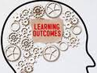
02
Learning Outcomes
Students will be able to:
See what a decision tree looks like and how it can be used to make predictions.
Learn how a decision tree learns from training data.
Learn the "impurity" metric "entropy" and how it's used when building a decision tree.
Learn when to use decision trees or neural networks.

Slide 5

03
References
1. Bishop, C. M. (2006). Pattern Recognition and Machine Learning. Springer.
2. Géron, A. (2019). Hands-On Machine Learning with Scikit-Learn, Keras, and TensorFlow. O'Reilly Media.
3. Murphy, K. P. (2012). Machine Learning: A Probabilistic Perspective. MIT Press.
4. Goodfellow, I., Bengio, Y., & Courville, A. (2016). Deep Learning. MIT Press.
5. Hastie, T., Tibshirani, R., & Friedman, J. (2009). The Elements of Statistical Learning: Data Mining, Inference, and Prediction. Springer.

Slide 6
04
Decision Trees

Slide 7
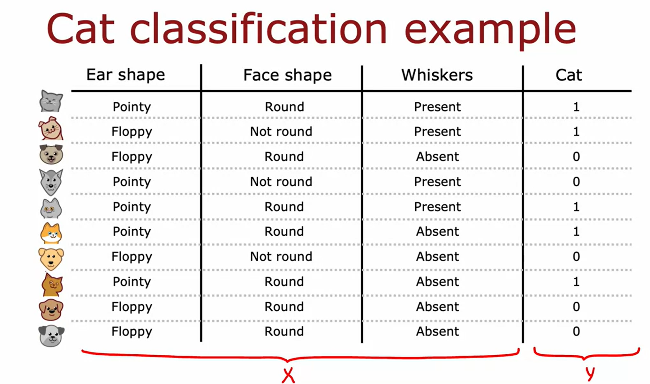
Decision Tree
04
Consider, you are running a cat adoption centre and given a few features, you want to train a classifier to quickly tell you if an animal is a cat or not. The image below has 10 training examples.

Slide 8
Decision Tree
04
With the 10 examples, we're going to have features regarding the animal's ear shape, face shape, whether it has whiskers, and then the ground truth label that you want to predict this animal as cat.
The first example has pointy ears, round face & whiskers which indicate cat.
The second example has floppy ears, the face shape is not round, whiskers are present, and yes, that is a cat, and so on for the rest of the examples.
This dataset has five cats and five dogs in it. The input features X are the first three columns, and the target output that you want to predict, Y, is the last (4th) column showing is this a cat or not?
In this example, the features X take on categorical values. In other words, the features take on just a few discrete values.
The ear shapes are either pointy or floppy.
The face shape is round or not round and whiskers are either present or absent. This is a binary classification task because the labels are either 1 or 0.

Slide 9
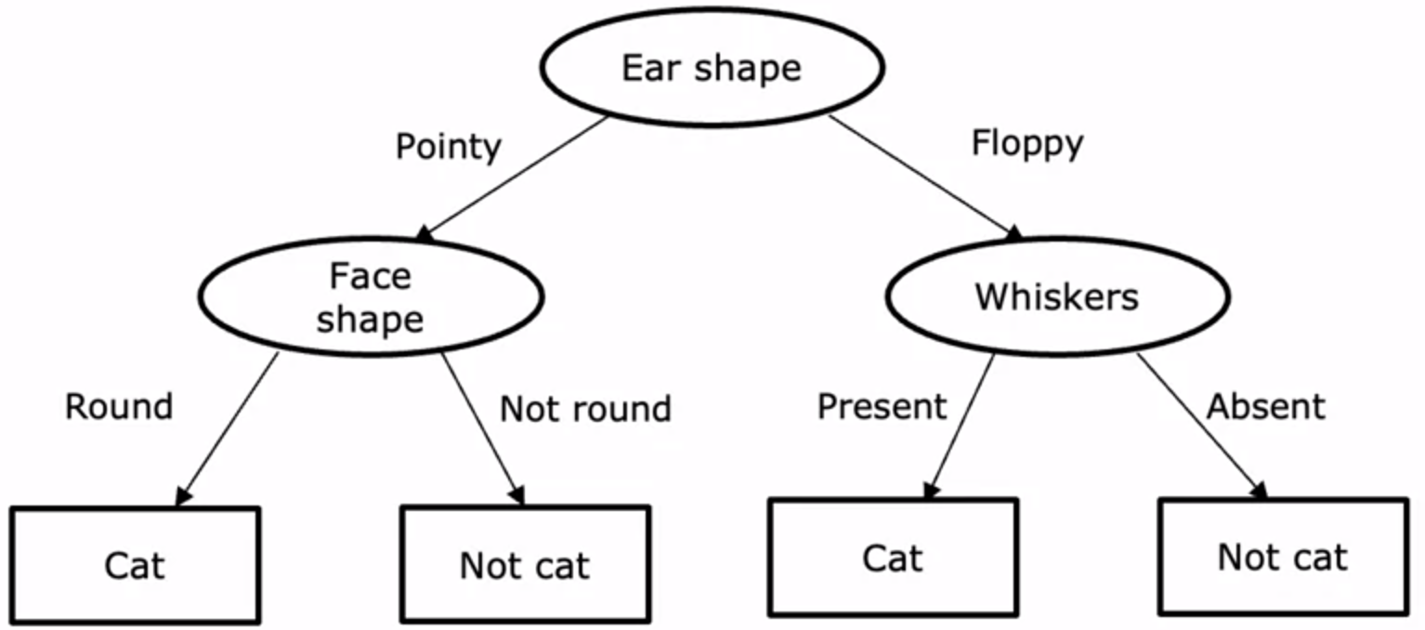
Decision Tree
04

Slide 10
Decision Tree
04
Consider a new test example, it is a cat if the ear-shaped is pointy, face shape is round, and whiskers are present. The model will make a classification decision by starting from the topmost node of the tree (called root node) and will look at the feature written inside, which is ear shape.
Based on the value of the ear shape, it will consider if to go left or right. The value of the ear-shape is pointy, and it will go to the left branch of the tree, and end up at this oval node called the decision node.
We then look at the face shape of the example, which turns out to be round, and so we will follow this arrow down over here. The algorithm will make a inference that it thinks this is a cat. You get to this node and the algorithm will make a prediction that this is a cat.
All of the oval shapes excluding the boxes at the bottom are called decision nodes because they look at a particular feature and then based on the value of the feature decides either to go left or right down the tree.
Finally, these nodes at the bottom symbolised with rectangular boxes are called leaf nodes which makes prediction.

Slide 11
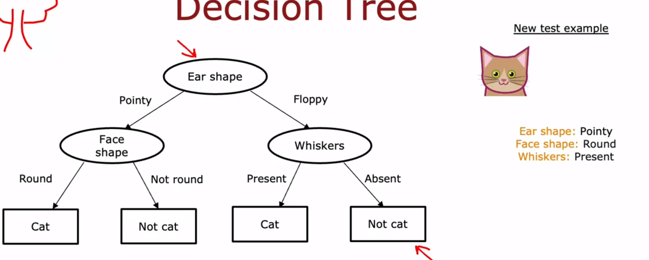
Decision Tree
04

Slide 12
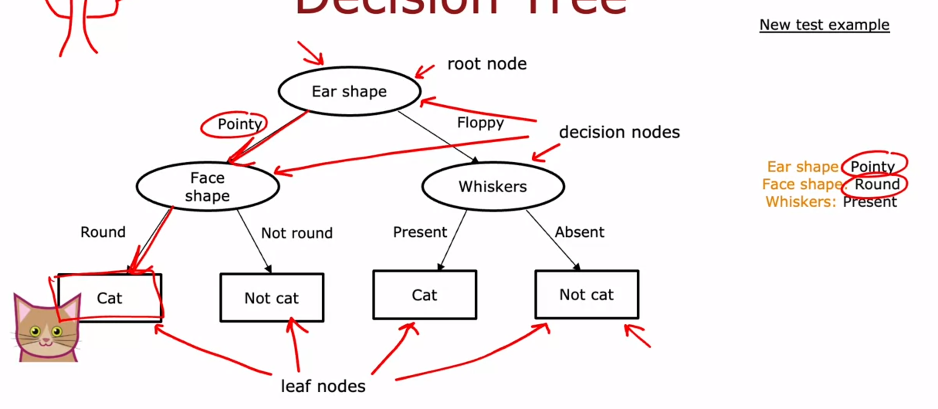
Decision Tree
04

Slide 13
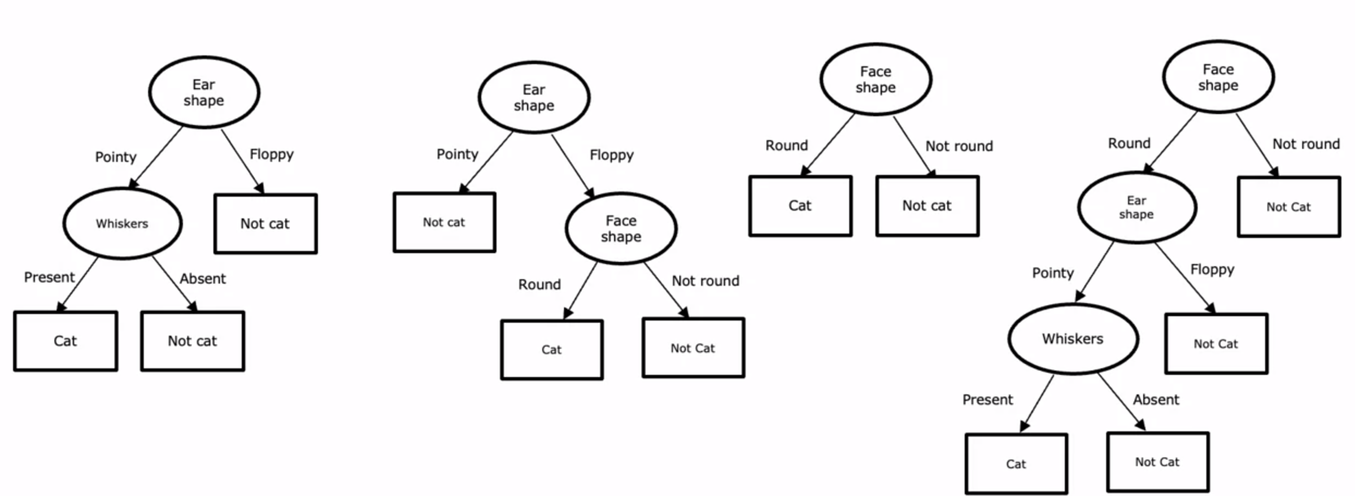
Decision Tree
04
Seems like there are lots of different decision trees one could build for a given application. How do you get an algorithm to learn a specific decision tree based on a training set?

Slide 14
Decision Trees Learning Process
05

Slide 15
Decision Tree Learning Process
05
The first step of decision tree learning is, we have to decide what feature to use at the root node. That is the first node at the very top of the decision tree. Let's say that we decided to pick as the Ear shape feature as the root node. So from the 10 training samples, we'll split according to the value of the ear shape feature via an algorithm.
In particular, let's pick out the five examples with pointy ears and move them over down to the left while floppy ears will be moved down to the right.
The second step is focusing just on the left part called the left branch of the decision tree to decide what nodes to put over there. Let's say you decide to use the face shape feature. What we'll do now is take these five examples on the left branch and split these five examples into two subsets based on their value of the face shape while we’ll take the four examples out of these five with a round face shape and move them down to the left. The one example without round face shape and move it down to the right.

Slide 16
Decision Tree
05
Rather than splitting further, we created a leaf node that makes a prediction if the animal is a cat or not cat.
Having done this on the left part to the left branch of this decision tree, we now repeat a similar process on the right part or the right branch of this decision tree.
Focus attention on just these five examples, which contains one for dog.
We would have to pick some feature over here to use the split these five examples further, if we end up choosing the whiskers feature, we would then split these five examples based on where the whiskers are present or absent, like so. You notice that one out of one examples on the left for cats and zeros out of four are cats.
Each of these nodes is completely pure, meaning that is, all cats or not cats and there's no longer a mix of cats and dogs. We can create these leaf nodes, making a ‘cat’ prediction on the left and ‘not a cat’ prediction here on the right. This is a process of building a decision tree.

Slide 17
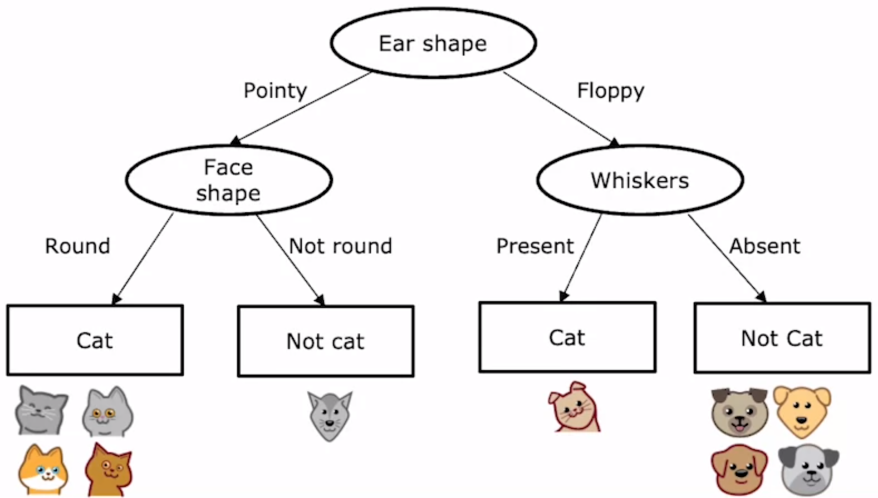
Decision Tree
05

Slide 18
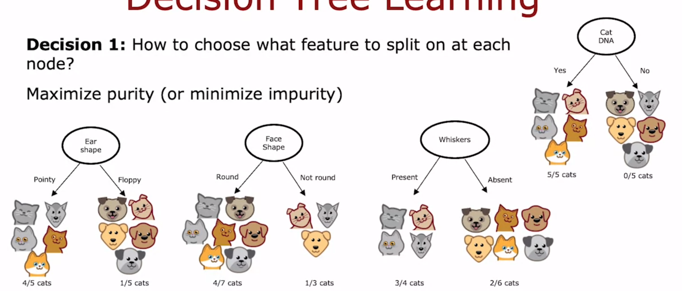
05
Key Decisions for Decision Tree
Decision 1: How to choose what feature to split on at each node?
Maximum purity (100% all cats or 100% all dogs)
Minimize impurity(reducing the mixture of both classes)

Slide 19
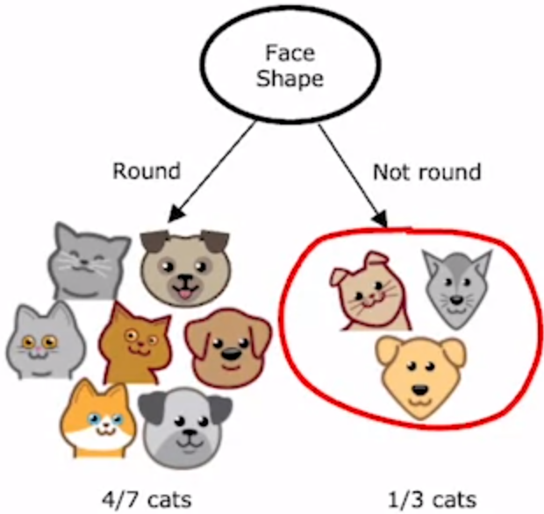
Decision Tree
04
Decision 2: When do you stop splitting?
When a node is 100% one class.
When splitting a node will result in the tree exceeding a maximum depth.
When improvements in purity score are below a threshold.
When number of examples in a node is below a threshold.

Slide 20
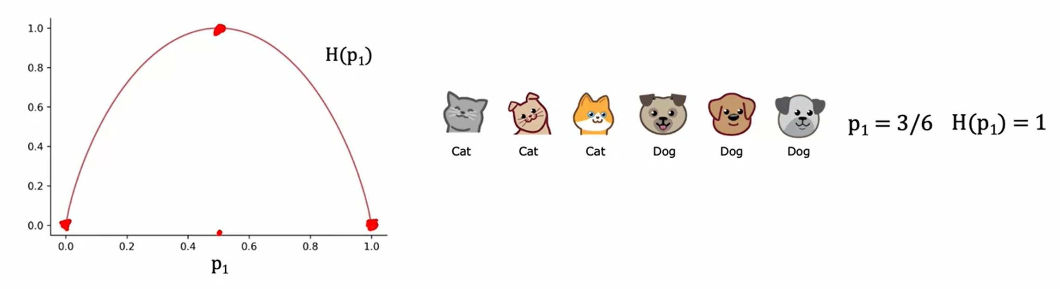
Decision Tree Learning – Measuring Impurity
04
Entropy as a measure of impurity of a set of data
p₁ = fraction of examples that are cats
The entropy function is denoted as H(p1)

Slide 21
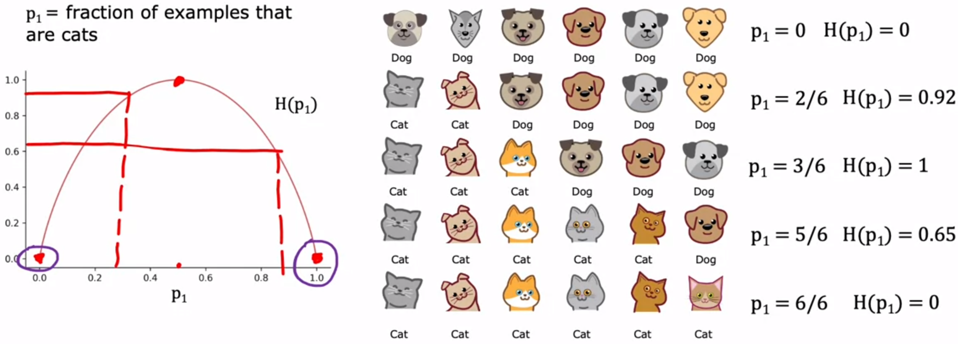
Decision Tree Learning – Measuring Impurity
04
It could be seen that the H(p1) impurity with different probabilities values of 3/6, 5/6 and 6/6 decreases from 1 to 0 or in other words the purity increases from 1 to 0.

Slide 22
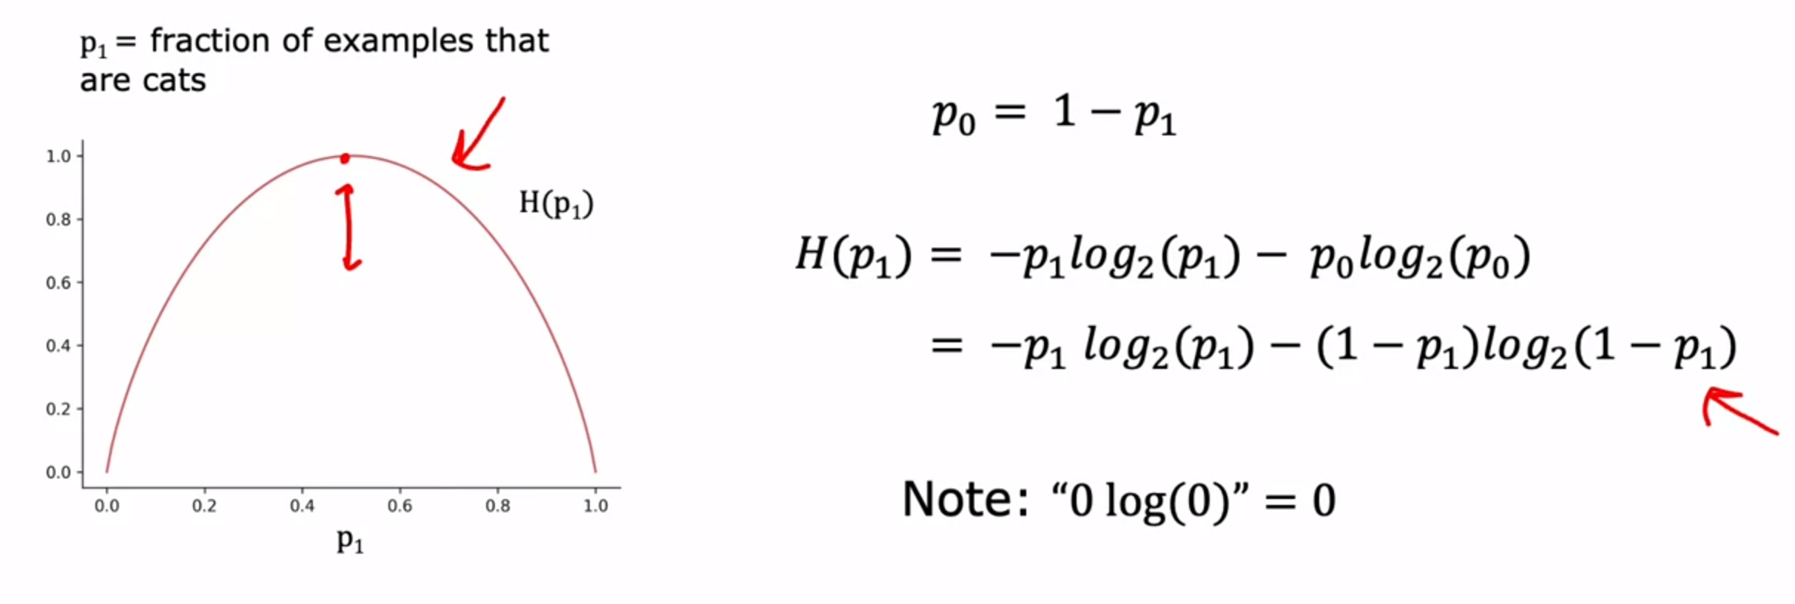
Actual Equation for the entropy Function, H(p_1)
04
Here is the formula to measure impurity:

Slide 23
06
Information Gain

Slide 24
Choosing a split: Information Gain
06
When building a decision tree, the way we'll decide what feature to split on at a node will be based on what choice of feature reduces entropy the most. Reduces entropy or reduces impurity, or maximizes purity. In decision tree learning, the reduction of entropy is called information gain
Let's use the example of deciding what feature to use at the root node of the decision tree we were building just now for recognizing cats versus not cats. If we had split using their ear shape feature at the root node, we’ll have figure 1, If we had split using their face shape feature at the root node, we’ll have figure 2 and If we had split using their whiskers feature at the root node, we’ll have figure 3 as all seen in the next slide.

Slide 25
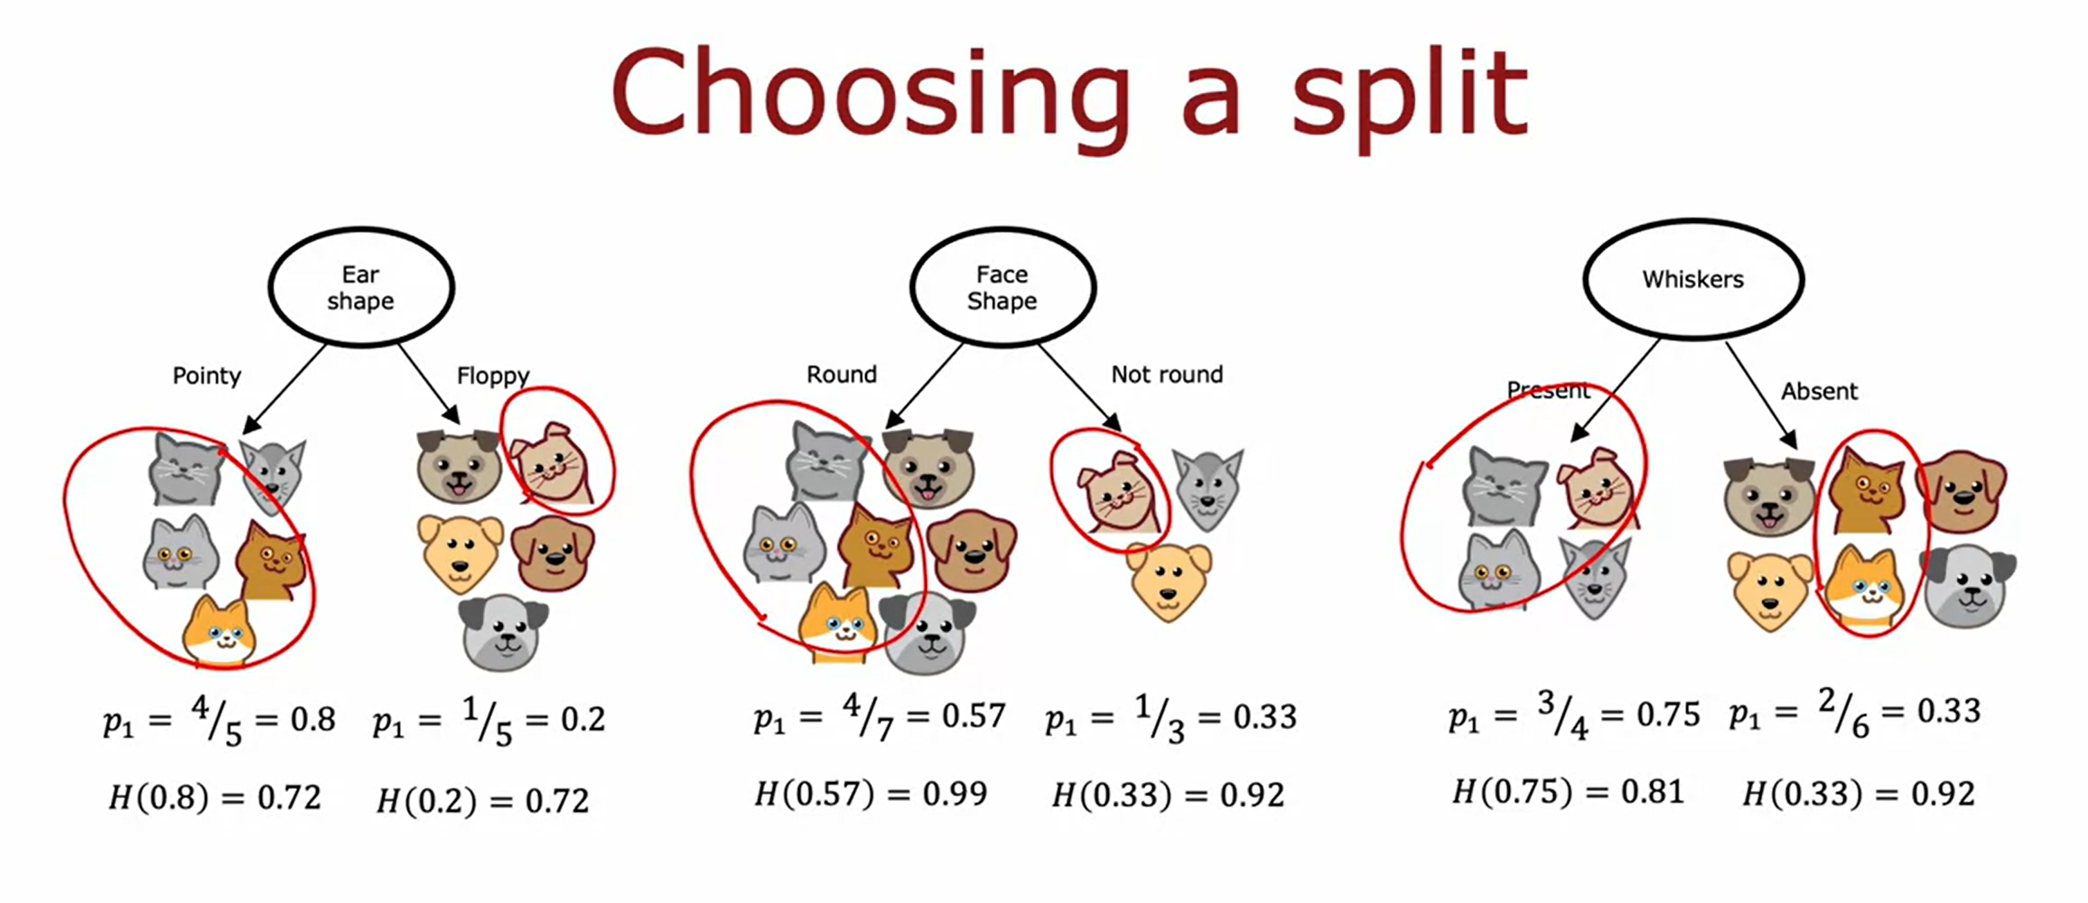
Choosing a split: Information Gain
06
Figure 2
Figure 3
Figure 1

Slide 26
Choosing a split: Information Gain
06
Question
The key question is which of these three possible choices of features should be used at the root node?
Answer
The best way is to combine the two numbers is by taking a weighted average and subtract from the entropy of the root node which is the maximum in purity.
Figure 1
Figure 2
Figure 3

Slide 27
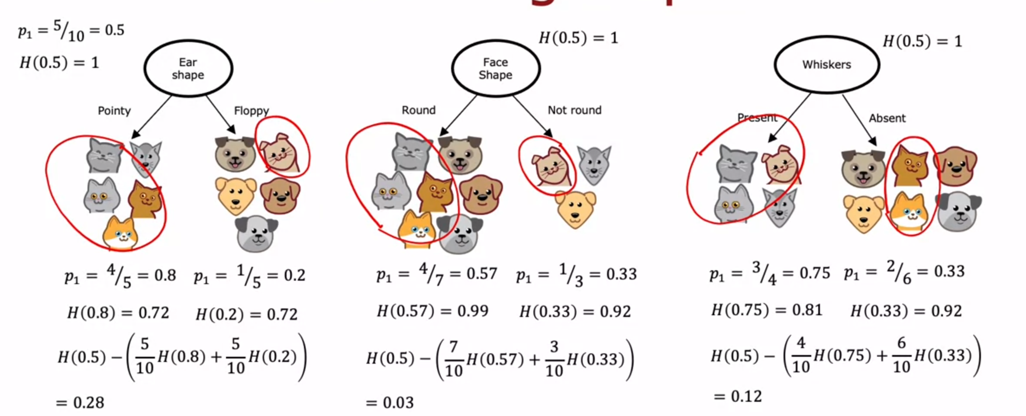
Choosing a split: Information Gain
06
Answer (Using Information Gain formula)
The best way is to combine the two numbers is by taking a weighted average and subtract from the entropy of the root node which is the maximum in purity.
Information Gain

Slide 28
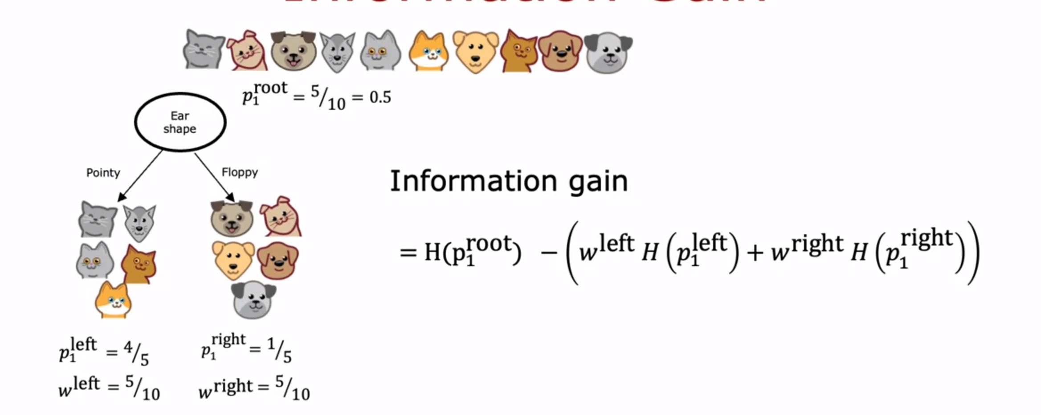
Information Gain Formula
06

Slide 29
07
Putting All Together

Slide 30
Putting All Together
07
Decision tree Learning
Start with all examples at the root node
Calculate information gain for all possible features, and pick the one with the highest information gain.
Split dataset according to the selected feature, and create left and right branches of the tree.
Keep repeating splitting process until stopping criteria is met:
When a node is 100% one class
When splitting a node will result in the tree exceeding a maximum depth.
Information gain from additional splits is less than threshold
When number of examples in a node is below a threshold

Slide 31
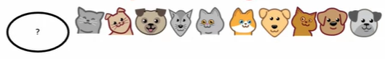
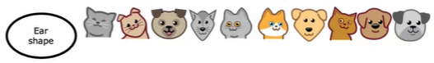
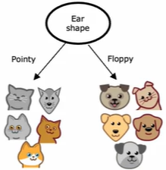
Recursive splitting
07
Select the root node using information gain calculation
create a left and right sub-branches

Slide 32
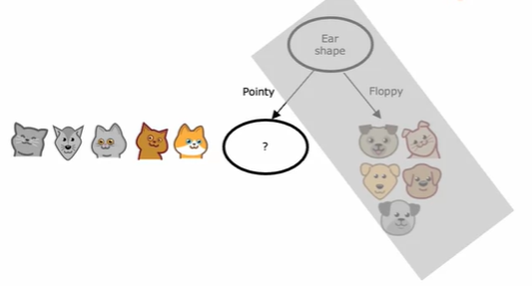
Recursive splitting
07
Select the root node using information gain calculation
Face shape
Round
Not Round

Slide 33
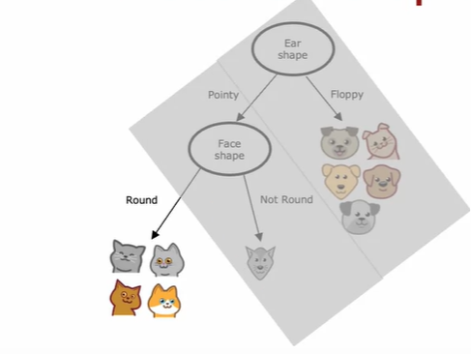
Recursive splitting
07
We're going to split on V-shape and that allows us to build left and right sub-branches as follows. For the left sub-branch, we check for the criteria for whether or not we should stop splitting and we have all cats here. The stopping criteria is met and we create a leaf node that makes a prediction of cat. For the right sub-branch, we find that it is all dogs.

Slide 34
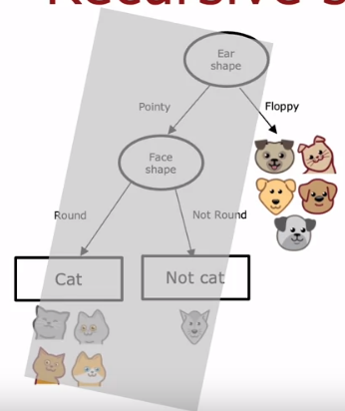
Recursive splitting
07
We’ll also stop splitting since we've met the splitting criteria and put a leaf node there, that predicts cat or not cat

Slide 35
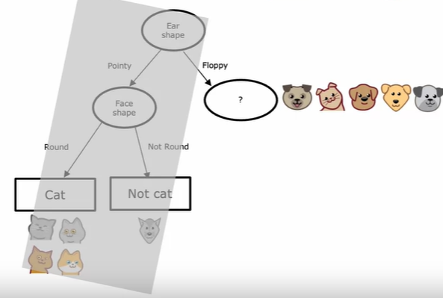
Recursive splitting
07
Select the root node using information gain calculation

Slide 36
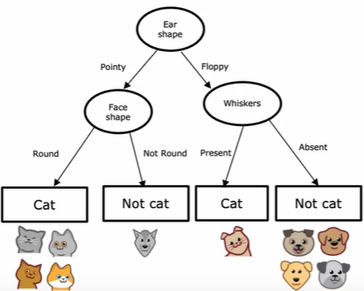
Putting All Together
07
At this end, we’ll arrive at this

Slide 37
08
Using one-hot encoding of categorical features

Slide 38
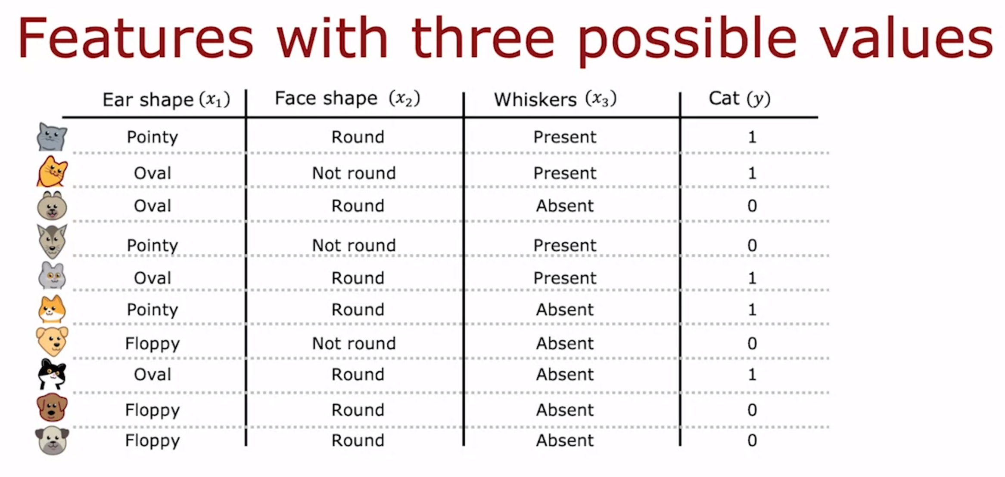
Using one-hot encoding of categorical features
08
Let consider if the ear shape takes on more than two discrete values(represented as pointy, oval and floppy in the Image below), thus we will utilise one-hot encoding to address these features too.

Slide 39
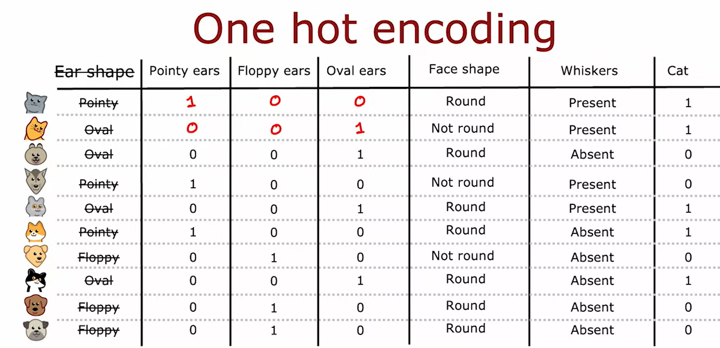
Using one-hot encoding of categorical features
08
If a categorical feature can take on k values, create k binary features (0 or 1 valued)
The representation of the one-hot encoding will flow in this manner below:

Slide 40
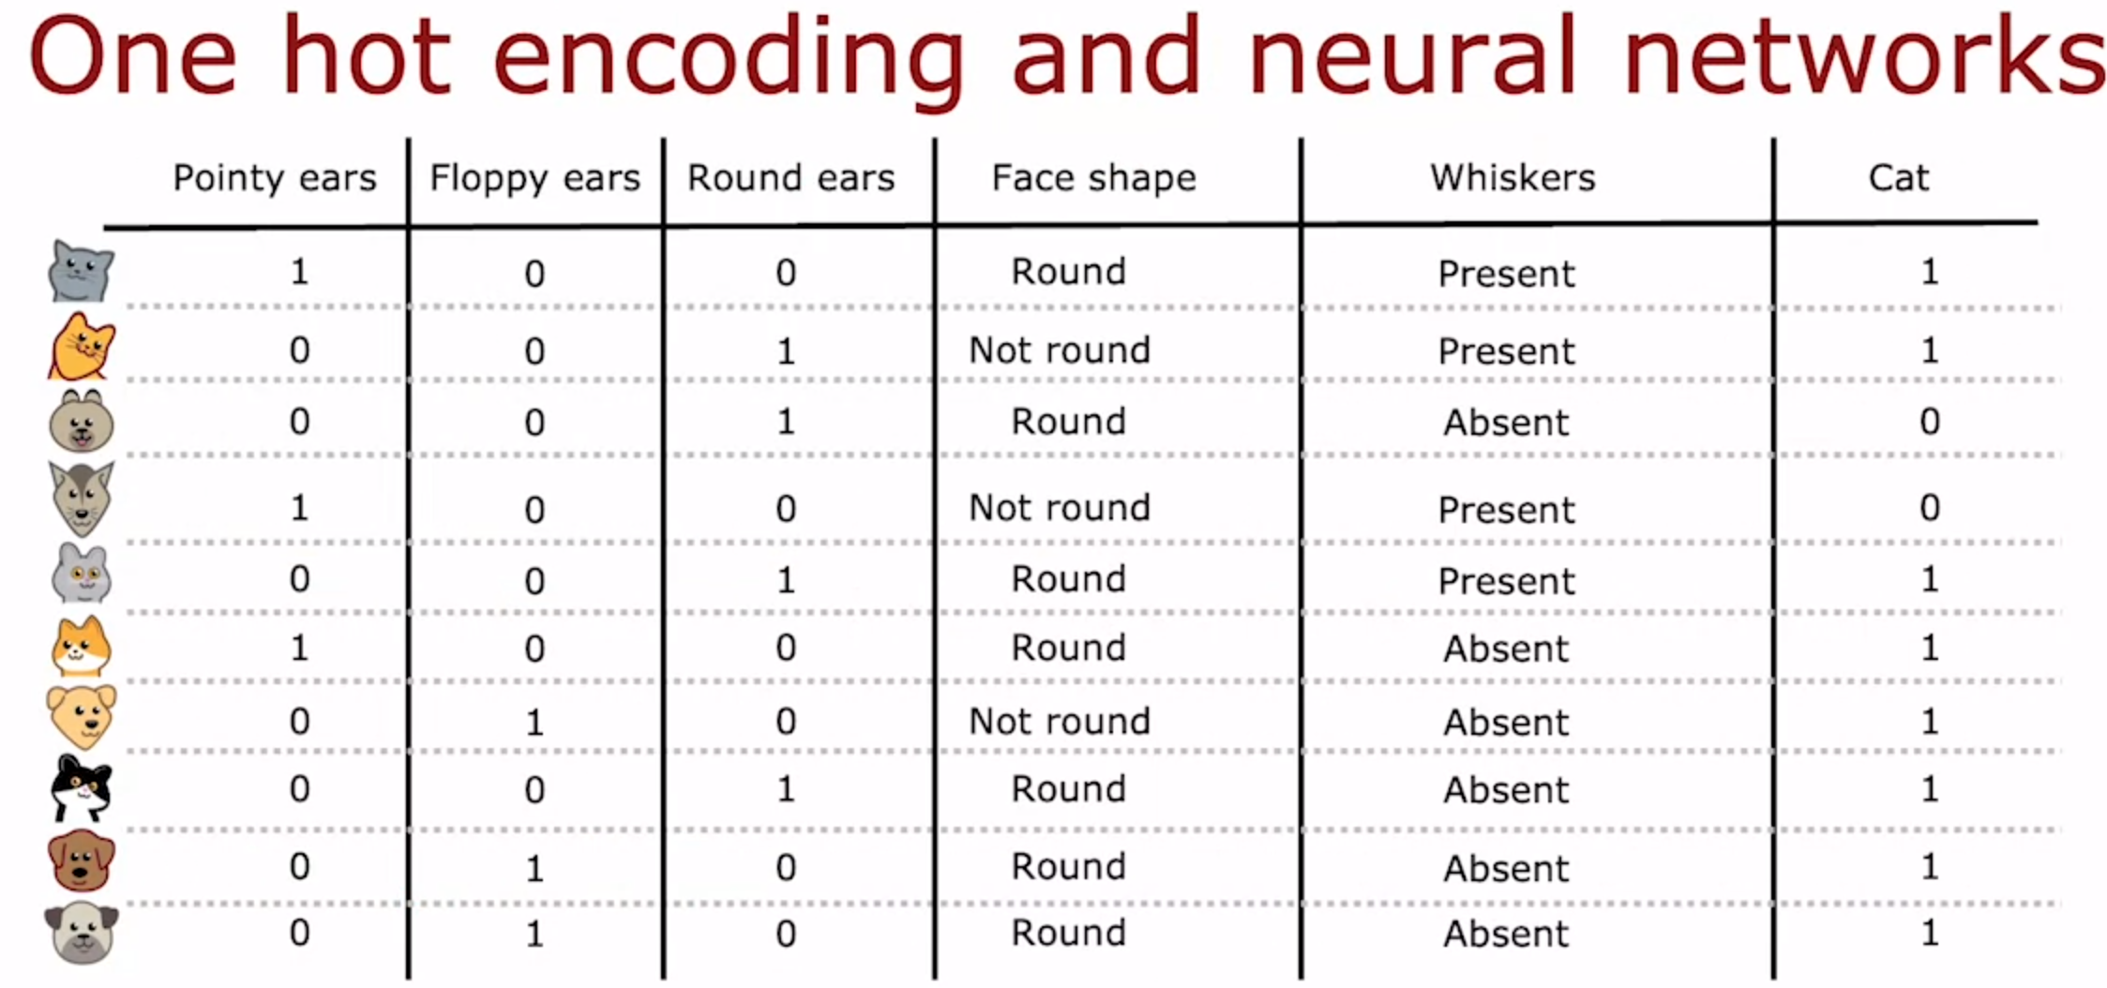
Using one-hot encoding of categorical features
08

Slide 41
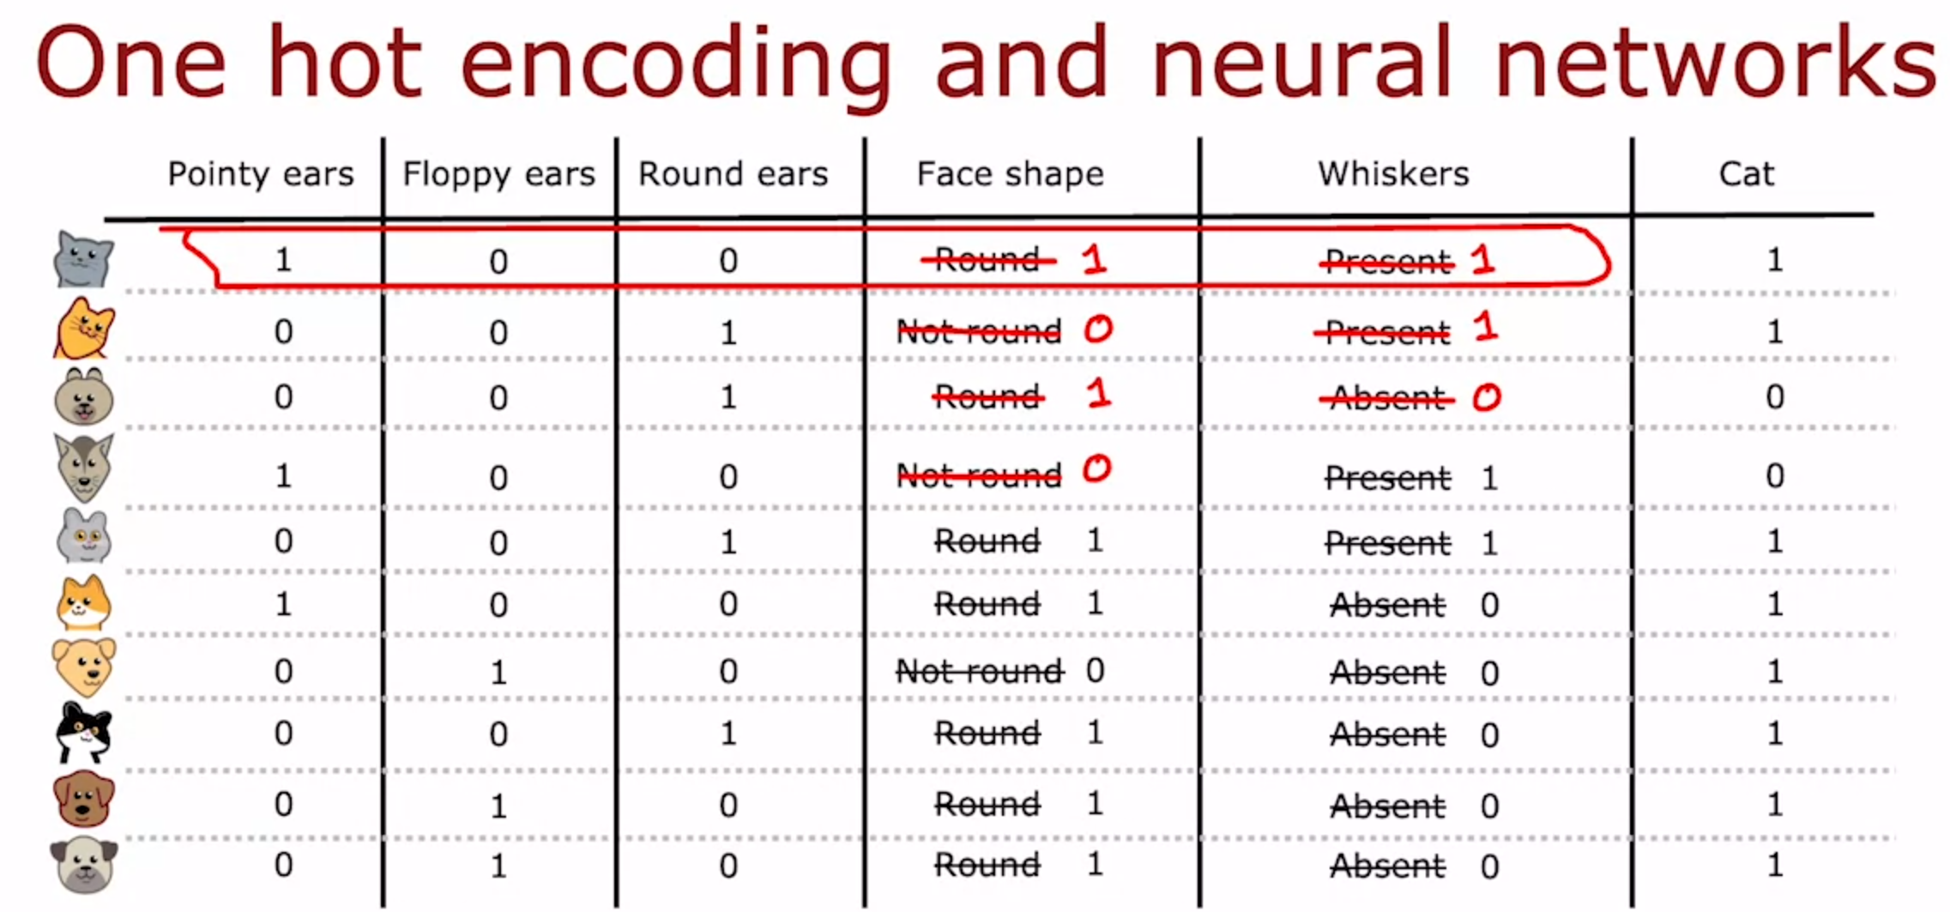
Using one-hot encoding in Neural Network
08

Slide 42
Using one-hot encoding in Neural Network
08

Slide 43
09
Seminar 1 –
Decision Tree

Slide 44
06
Seminar 1 – Decision Tree (Instructions)
Let’s understand how decision tree works
You’ll explore the implementation of decision tree.
Open the ‘W7_Decision_Trees.ipynb’ file.

Slide 45
06
Seminar 1 – Decision Tree
Open the jupyter notebook file titled
‘W7_Decision_Trees.ipynb’
on your browser.

Slide 46
Thanks for Listening

